Slide 1

Welcome

Slide 2

Analysis of Big Data
DATA 6300/CIS 6180
Winter 2024
University of Guelph
Lecturer in Charge: Taiwo Omomule, PhD.

Slide 3
EXPLORATORY DATA ANALYSIS
(EDA)

Slide 4
What is EDA?
The analysis of datasets based on various numerical methods and graphical tools.
Exploring data for patterns, trends, underlying structure, deviations from the trend, anomalies and strange structures.
It facilitates discovering unexpected as well as conforming the expected.
Another definition: An approach/philosophy for data analysis that employs a variety of techniques (mostly graphical).
4

Slide 5
EDA
Exploring your data is a crucial step in data analysis. It involves:
Organising the data set
Plotting aspects of the data set
Maybe producing some numerical summaries; central tendency and spread, etc.
“Exploratory data analysis can never be the whole story, but nothing else can serve as the foundation stone.” - John Tukey.

Slide 6
6

Slide 7
Aim of EDA
Maximize insight into a dataset
Uncover underlying structure
Extract important variables
Detect outliers and anomalies
Test underlying assumptions
Develop valid models
Determine optimal factor settings (Xs)
7

Slide 8
Aim of EDA
The goal of EDA is to open-mindedly explore data.
Tukey: EDA is detective work… Unless detective finds the clues, judge or jury has nothing to consider.
Here, judge or jury is a confirmatory data analysis
Tukey: Confirmatory data analysis goes further, assessing the strengths of the evidence.
With EDA, we can examine data and try to understand the meaning of variables. What are the abbreviations stand for.
8

Slide 9
Exploratory vs Confirmatory Data Analysis
EDA | CDA
No hypothesis at first Generate hypothesis Uses graphical methods (mostly) | Start with hypothesis Test the null hypothesis Uses statistical models
9

Slide 10
Steps of EDA
Generate good research questions
Data restructuring: You may need to make new variables from the existing ones.
Instead of using two variables, obtaining rates or percentages of them
Creating dummy variables for categorical variables
Based on the research questions, use appropriate graphical tools and obtain descriptive statistics. Try to understand the data structure, relationships, anomalies, unexpected behaviors.
10

Slide 11
Steps of EDA
Try to identify confounding variables, interaction relations and multi-collinearity, if any.
Handle missing observations
Decide on the need of transformation (on response and/or explanatory variables).
Decide on the hypothesis based on your research questions
Confirmatory Data Analysis: Verify the hypothesis by statistical analysis
Get conclusions and present your results nicely.
11

Slide 12
Classification of EDA
EDA is generally cross-classified in two ways.
Non-graphical
Graphical method-> Univariate or Multivariate (usually just bivariate).
Non-graphical methods generally involve calculation of summary statistics, while graphical methods obviously summarize the data in a diagrammatic or pictorial way.
Univariate methods look at one variable (data column) at a time, while multivariate methods look at two or more variables at a time to explore relationships.
*Seltman, H.J. (2015). Experimental Design and Analysis. http://www.stat.cmu.edu/~hseltman/309/Book/Book.pdf
12

Slide 13
Classification of EDA
Usually multivariate EDA will be in the form bivariate EDA (looking at exactly two variables), but occasionally it will involve three or more variables.
It is almost always a good idea to perform univariate EDA on each of the components of a multivariate EDA before performing the multivariate EDA.
*Seltman, H.J. (2015). Experimental Design and Analysis. http://www.stat.cmu.edu/~hseltman/309/Book/Book.pdf
13

Slide 14
Classification of EDA
Univariate: Summarize and visualize the distribution of a single variable, assess its central tendency (mean, median, mode), dispersion (range, variance, standard deviation), and shape (e.g., histogram, bar-graph, box plot). It helps in understanding the characteristics of a single variable in isolation.
Multivariate: Used to understand the relationship, correlation, or association between two or more variables. Common techniques include scatter plots, pie plots, heatmaps, correlation coefficients (e.g., Pearson’s correlation), and contingency tables (for categorical variables). It helps answer questions like, “Is there a relationship between a person’s age and their income?”

Slide 15
Example 1
Data from the Places Rated Almanac (Boyer and Savageau, 1985)
9 variables fro 329 metropolitan areas in the USA
Climate mildness
Housing cost
Health care and environment
Crime
Transportation supply
Educational opportunities and effort
Arts and culture facilities
Recreational opportunities
Personal economic outlook
10 latitude and longitude of each city
Questions:
How is climate related to location?
Are there clusters in the data (excluding location)?
Are nearby cities similar?
Any relation bw economic outlook and crime?
What else???
15

Slide 16
Example 2
In a breast cancer research, main questions of interest might be
Does any treatment method result in a higher survival rate?
Can a particular treatment be suggested to a woman with specific characteristic?
Is there any difference between patients in terms of survival rates (e.g. Are white woman more likely to survive compare the black woman if they are both at the same stage of disease?)
16

Slide 17
Example 3
In a project, investigating the well-being of teenagers after an economic hardship, main questions can be
Is there a positive (and significant) effect of economic problems on distress?
Which other factors can be most related to the distress of teenagers? e.g. age, gender,…?
17

Slide 18
Data Types and Measurement Scales
Variables may be one of several types, and have a defined set of valid values.
Two main classes of variables are:
Continuous Variables: (Quantitative, numeric).: Continuous data can be rounded or binned to create categorical data.
Categorical Variables: (Discrete, qualitative).: Some categorical variables (e.g. counts) are sometimes treated as continuous.
18

Slide 19
Summarizing Variables
Categorical variables
Frequency tables - how many observations in each category?
Relative frequency table - percent in each category.
Bar chart and other plots.
Continuous variables
Bin the observations (create categories .e.g., (0-10), (11-20), etc.) then, treat as ordered categorical.
Plots specific to Continuous variables.
The goal for both categorical and continuous data is data reduction while preserving/extracting key information about the process under investigation.

Slide 20
Reading in the Data
First we import the Python packages we are going to use.
Then we use Pandas to load in a Pokeman dataset as a data frame.
NOTE: The argument index_col argument states that we'll treat the first column of the dataset as the ID column.
NOTE: The encoding argument allows us to by pass an input error created by special characters in the data set.

Slide 21
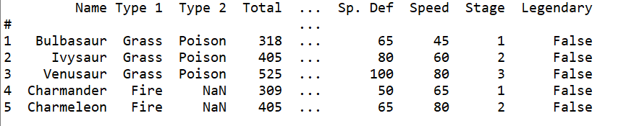
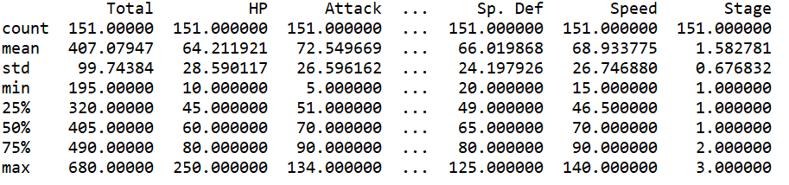
Examining in the Data

Slide 22
Preliminary Thought Process
We could spend time staring at these numbers, but that is unlikely to offer us any form of insight.
We could begin by conducting all of our statistical tests.
However, a good field commander never goes into battle without first doing a recognisance of the terrain…
This is exactly what EDA is for…

Slide 23
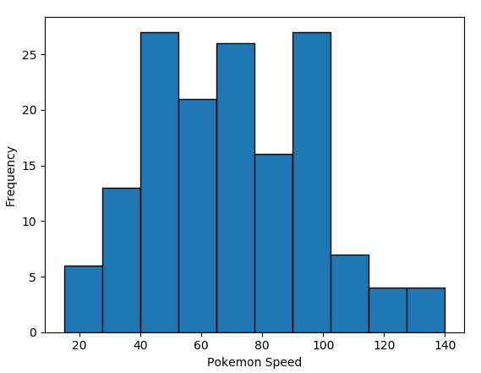
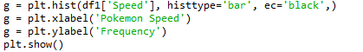
Plotting a histogram in Python

Slide 24
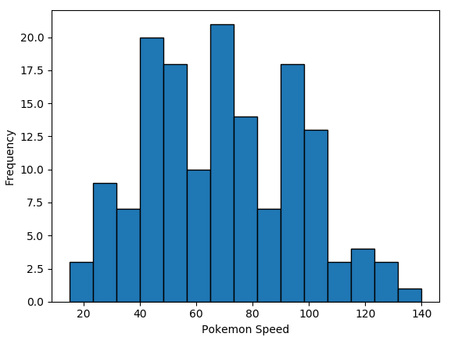
Bins
You may have noticed the two histograms we’ve seen so far look different, despite using the exact same data.
This is because they have different bin values.
The left graph used the default bins generated by plt.hist(), while the one on the right used bins that I specified.

Slide 25
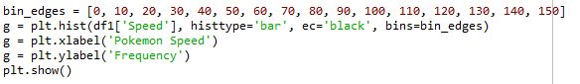
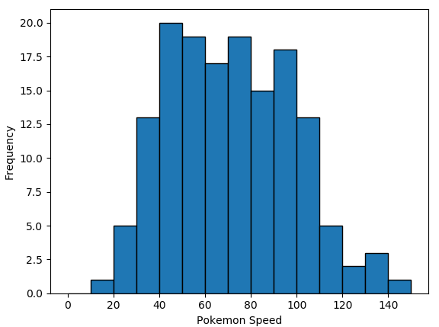
There are a couple of ways to manipulate bins in matplotlib.
Here, I specified where the edges of the bars of the histogram are; the bin edges.

Slide 26
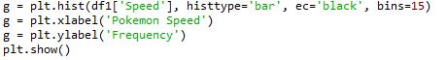
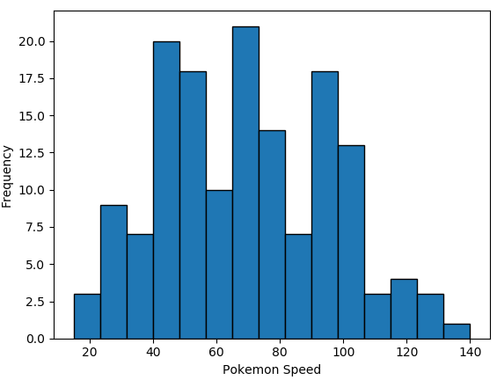
You could also specify the number of bins, and Matplotlib will automatically generate a number of evenly spaced bins.

Slide 27
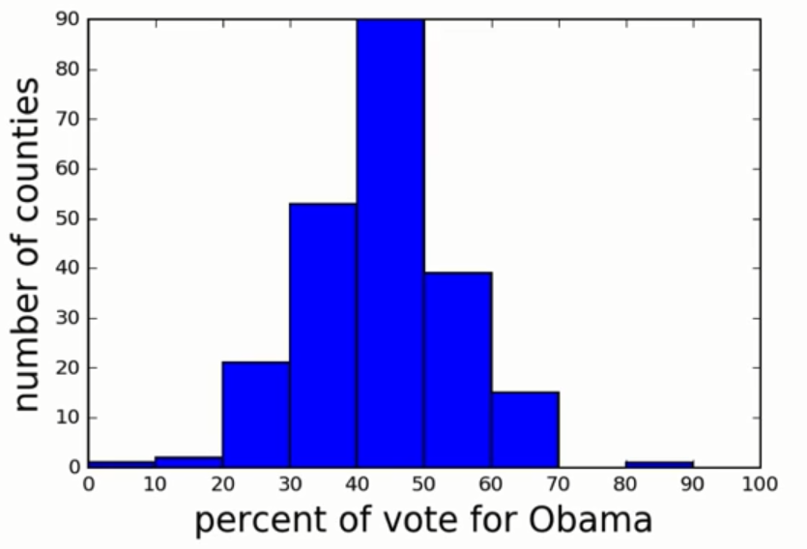
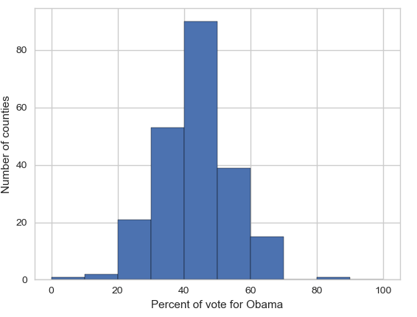
Seaborn
Matplotlib is a powerful, but sometimes unwieldy, Python library.
Seaborn provides a high-level interface to Matplotlib and makes it easier to produce graphs like the one on the right.
Some IDEs incorporate elements of this “under the hood” nowadays.

Slide 28
Benefits of Seaborn
Seaborn offers:
- Using default themes that are aesthetically pleasing.
- Setting custom colour palettes.
- Making attractive statistical plots.
- Easily and flexibly displaying distributions.
- Visualising information from matrices and DataFrames.
The last three points have led to Seaborn becoming the exploratory data analysis tool of choice for many Python users.

Slide 29
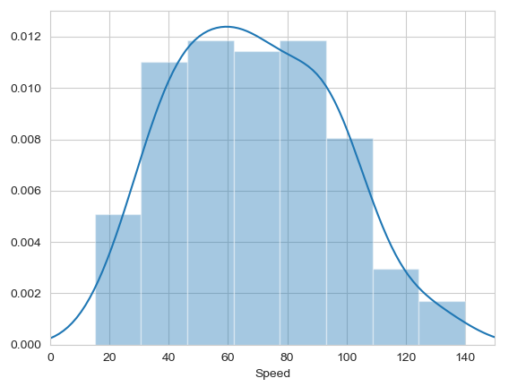
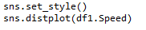
Histograms
Allow you to plot the distributions of numeric variables.

Slide 30
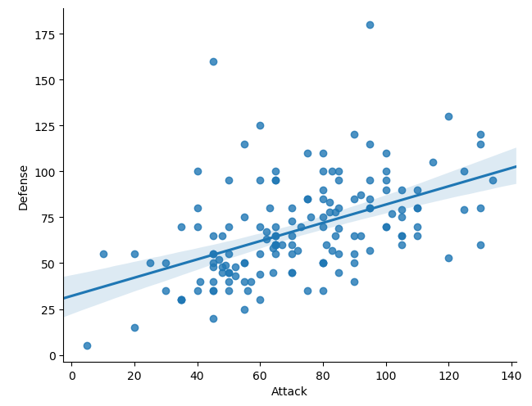
Other Types of Graphs: Scatterplot
Name of our dataframe fed to the “data=“ command
Name of variable we want on the x-axis
Seaborn “linear model plot” function for creating a scatter graph
Name of variable we want on the y-axis

Slide 31
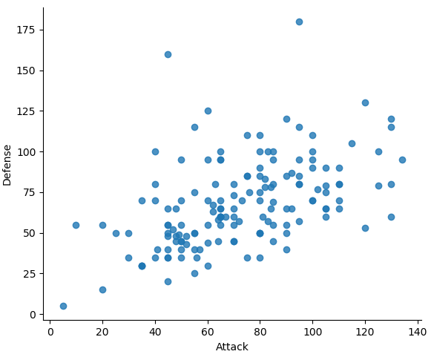
Seaborn doesn't have a dedicated scatter plot function.
We used Seaborn's function for fitting and plotting a regression line; hence lmplot()
However, Seaborn makes it easy to alter plots.
To remove the regression line, we use the fit_reg=False command

Slide 32
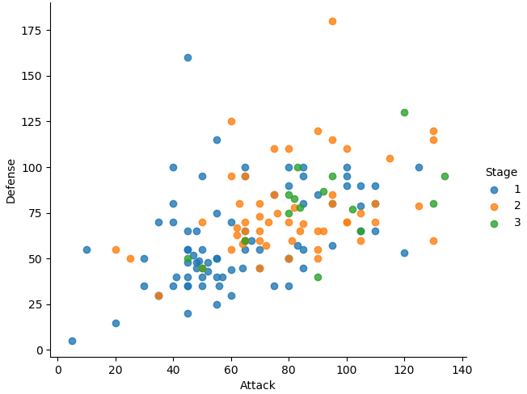
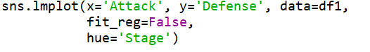
The Hue Function
Another useful function in Seaborn is the hue function, which enables us to use a variable to colour code our data points.

Slide 33
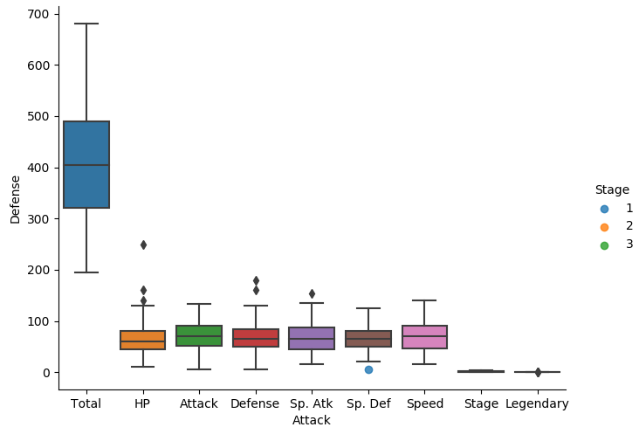
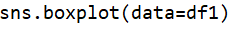
Boxplot

Slide 34
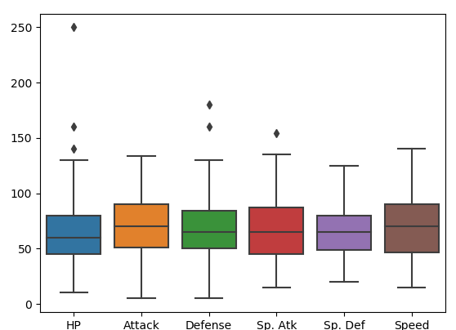
The total, stage, and legendary entries are not combat stats so we should remove them.
Pandas makes this easy to do, we just create a new dataframe
We just use Pandas’ .drop() function to create a dataframe that doesn’t include the variables we don’t want.

Slide 35
Violin Plot
Violin plots are useful alternatives to box plots.
They show the distribution of a variable through the thickness of the violin.
Here, we visualise the distribution of attack by Pokémon's primary type:

Slide 36
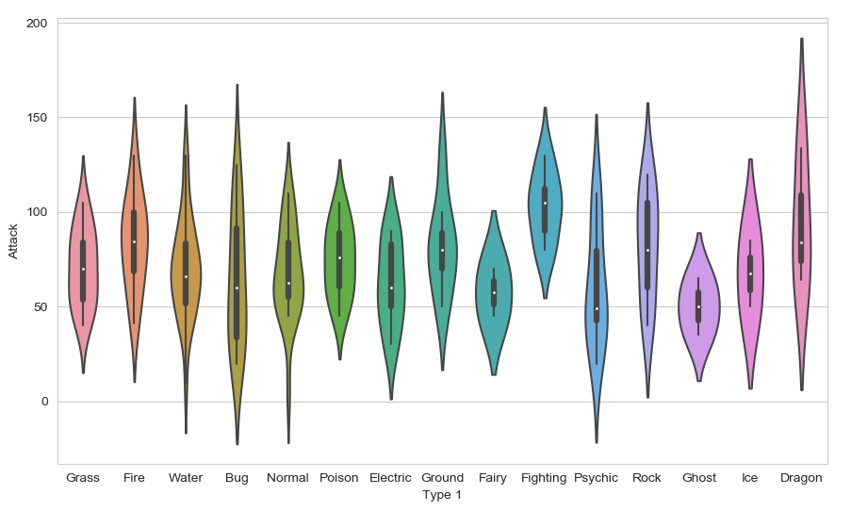
Dragon types tend to have higher Attack stats than Ghost types, but they also have greater variance. But there is something not right here….
The colours!

Slide 37
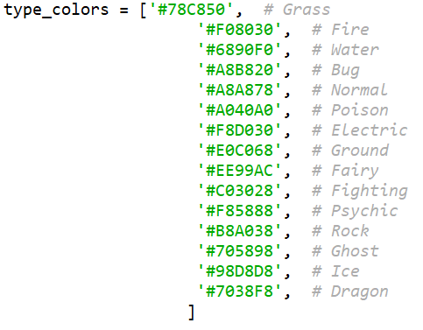
Seaborn’s Colour Palettes
Seaborn allows us to easily set custom colour palettes by providing it with an ordered list of colour hex values.
We first create our colours list.

Slide 38
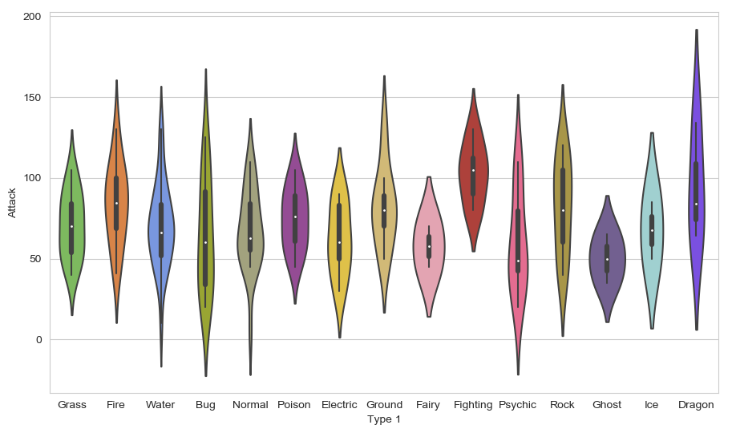
Then we just use the palette= function and feed in our colours list.

Slide 39
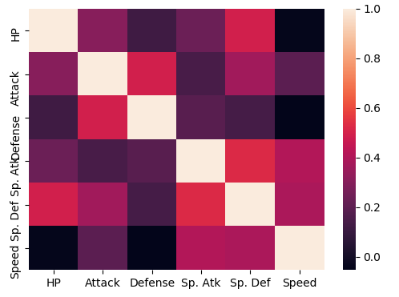
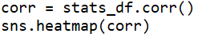
Heatmaps
Useful for visualising matrix-like data.
Here, we’ll plot the correlation of the stats_df variables

Slide 40
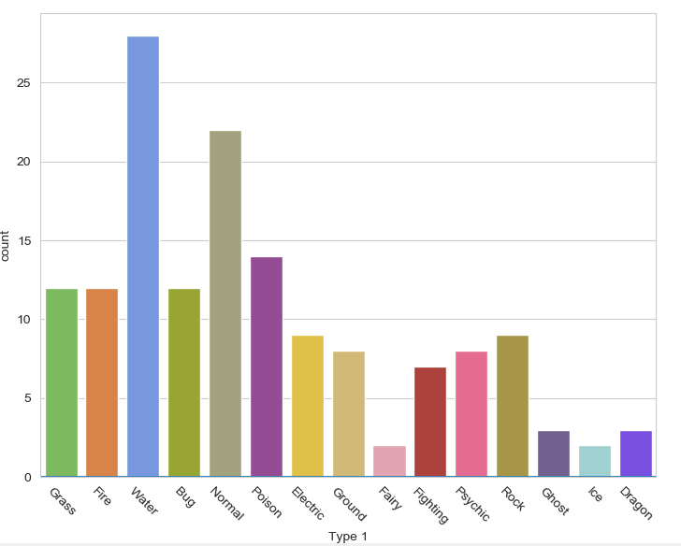
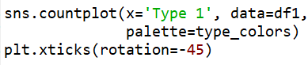
Bar plot
Visualises the distributions of categorical variables.
Rotates the x-ticks 45 degrees

